Slide 1
Design and Analysis of Algorithms (UE18CS251)
Unit I - Introduction
Mr. Channa Bankapur
channabankapur@pes.edu

Slide 2
Design and Analysis of Algorithms (UE18CS251)
4 Credits, 4 lecture hours per week
ISA: 40 = 15 (T1: CBT of 40 marks) +
15 (T2: CBT of 40 marks) +
10 (Assignments).
ESA: 60 (Scaled from 100 marks theory paper)
Student Course Folder of DAA UE18CS251
tinyurl.com/UE18CS251

Slide 3
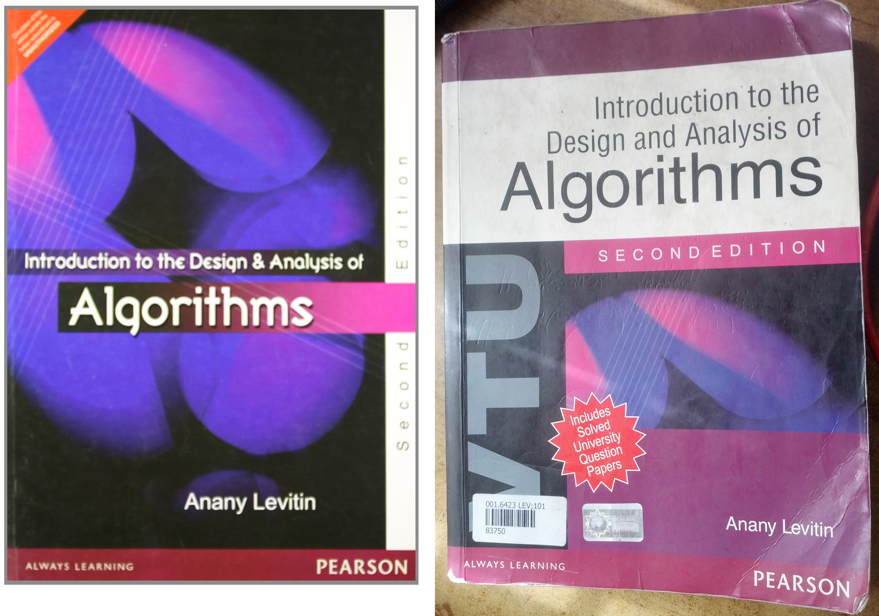

Slide 4
Syllabus:
UNIT I
Introduction, Analysis of Algorithm Efficiency
UNIT II
Brute Force, Decrease-and-Conquer
UNIT III
Divide-and-Conquer, Transform-and-Conquer
UNIT IV
Space-and-Time Tradeoffs, Backtracking, Greedy Approach
UNIT V
Dynamic Programming, Limitations of Algorithm Power,
Coping with the Limitations of Algorithm Power

Slide 5


Slide 6
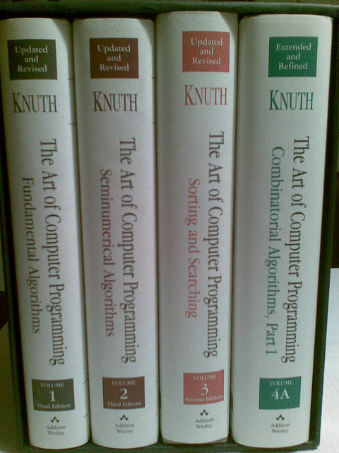
Donald Knuth
b. Jan 10, 1938
Computer Scientist
@Stanford University
Authored:
The Art of Computer Programming
Vol 1-4 Published
Vol 5 in the making
Vol 6-7 Planned

Slide 7
Donald Knuth said..
A person well trained in CS knows how to deal with algorithms; how to construct them, manipulate them, understand them and analyze them. This knowledge is much more than writing good computer programs; it’s a general-purpose mental tool..
It has often been said that a person doesn’t really understand something until after teaching it to someone else. Actually, a person doesn’t really understand something until after teaching it to a computer i.e., expressing it as an algorithm..
An attempt to formalize things as algorithms leads to a much deeper understanding..

Slide 8
Why do you need to study algorithms?
It’s a mandatory course :-(
Algorithmics is core to Computer Science.
Computer programs wouldn’t exist without algorithms.
To design new algorithms and analyze their efficiency.
To familiarize with a standard set of important algorithms in CS.
To enhance your analytical skills. Algorithms can be seen as special kinds of solutions - not closed form answers, but a precisely defined procedures for getting answers.
Job interviews of theoretical or applied CS.

Slide 9
Algorithms all over the place...
Operating Systems: Job Sequencing, Process Scheduling, Deadlock Avoidance, Heap Allocation, Page Replacement, Disk Scheduling…
Computer Networks: Congestion Control, Huffman Coding, Encryption/Decryption, Data Encoding, Data Compression,…
DBMS: B Trees, B+ Trees, Concurrency Control, Normalization, …
Compilers: Parser Algorithms, Code Generation Algorithms, Symbol Table Related Algorithms, …
Web: Page Ranking Algorithm, XML Parsers, …
Mobile: Routing Algorithms, Address Book, …
Image Processing: Edge Detection, Contrast Enhancement, Image Smoothing, …

Slide 10
Computer Graphics: Line Clipping, Shading, Polygon Clipping, Morphing, Animation, …
System Modeling and Simulation: Pseudo-Random Number Generators, Discrete Event Simulation Algorithms, …
Numerical Algorithms: Root Finding, ODE & PDE, Eigen Values & Eigen Vectors, Integration,…
Text Processing Algorithms: Searching, Sorting, Regular Expression Matching, Binary Search Trees,…
Operations Research: Linear Programming, Integer Programming, Scheduling, Assignment, Inventory Control,…
Game Theory: Cooperative Games, Competitive Games, Mechanism Design, …

Slide 11
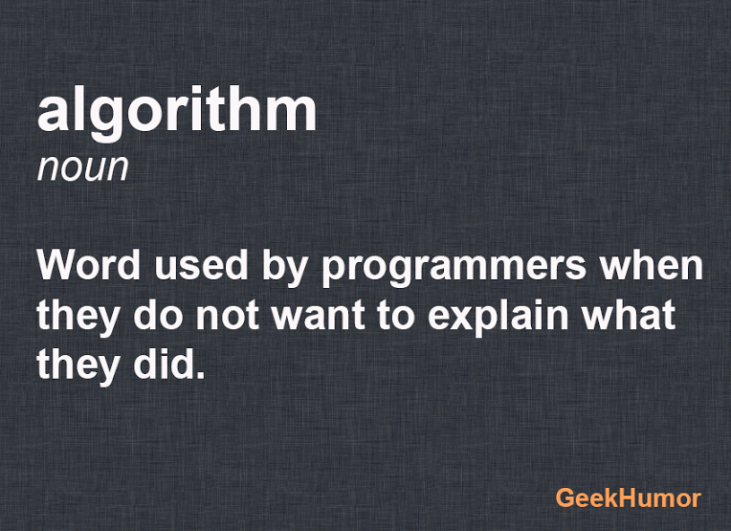
Let’s begin..
What is an algorithm?
Definition: …
Hint: What are the common things out
of a bunch of
algorithms you are familiar with?

Slide 12
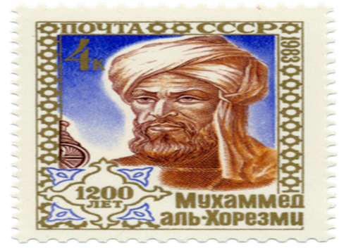
A stamp issued September 6, 1983 in the Soviet Union, commemorating al-Khwārizmī's (approximate) 1200th birthday.
( CE 780 - CE 850)

Slide 13
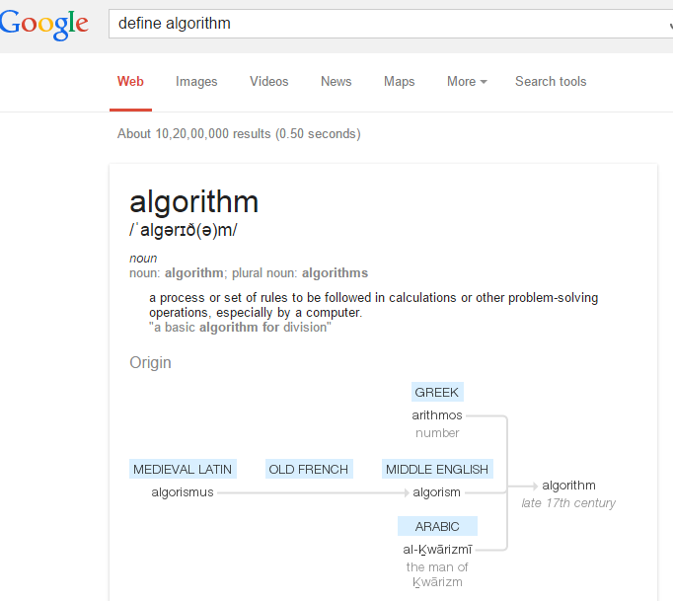

Slide 14
Textbook definition of an algorithm:
“An algorithm is a sequence of unambiguous instructions for solving a problem i.e., for obtaining a required output for any legitimate input in a finite amount of time.”
Instructions (a computer can understand)
Sequence of instructions
Unambiguous instructions
Solving a problem
legitimate input
required output
finite amount of time

Slide 15
Algorithm for computing GCD (m, n)
…
Eg: GCD(60, 24)
12 is the GCD(60, 24).

Slide 16
Algorithm for computing GCD (m, n)
Assign the value of min {m, n} to t.
If t divides both m and n, return the value of t as the answer and stop.
Decrease the value of t by 1. Go to Step 2.
Eg: GCD (60, 24)
m = 60, n = 24, t = 24.
24 (doesn’t divide m), 23, 22, …, 12.
12 divides both 60 and 24.
Hence, 12 is the GCD(60, 24).
Does it work for all the legitimate input?

Slide 17
Algorithm for computing GCD (m, n)
Assign the value of min {m, n} to t.
If the value of t is zero, return max{m, n} as the answer and stop.
If t divides both m and n, return the value of t as the answer and stop.
Decrease the value of t by 1. Go to Step 3.
Eg: GCD (55, 0)
m = 55, n = 0, t = 0.
Max{55, 0} is 55.
Hence, 55 is the GCD(55, 0).

Slide 18
Pseudocode of the algorithm: (Flowcharts?)
Algorithm GCD(m,n)
//Computes gcd(m,n) by checking consecutive integers.
//Input: Two nonnegative, not-both-zero integers m, n.
//Output: GCD of m and n.
t ← min{m, n}
if (t = 0) return max{m, n}
while (! ((m mod t = 0) and (n mod t = 0)) )
t ← t - 1
return t

Slide 19
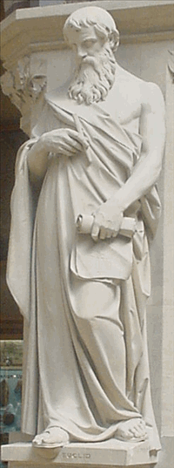
Euclid of Alexandria (around 300 BC)
Euclid’s Algorithm uses
gcd(m,n) = gcd(n, m mod n)
and gcd(m, 0) = m
E.g.: gcd(60, 24)
= gcd(24, 12)
= gcd(12, 0) = 12
E.g.: gcd(252, 105)
= gcd(105, 42)
= gcd(42, 21)
= gcd(21, 0) = 21

Slide 20
Pseudocode of the Euclid’s algorithm:
(recursive)
Algorithm GCD_Euclid_Recursive(m,n)
//Computes gcd(m,n) by Euclid’s algorithm.
//Input: Two nonnegative, not-both-zero integers m, n.
//Output: GCD of m and n.
if (n = 0)
return m
return GCD_Euclid_Recursive(n, m mod n)

Slide 21
Pseudocode of the Euclid’s algorithm:
Algorithm GCD_Euclid_Iterative(m,n)
//Computes gcd(m,n) by Euclid’s algorithm.
//Input: Two nonnegative, not-both-zero integers m, n.
//Output: GCD of m and n.
while (n ≠ 0)
r ← m mod n
m ← n
n ← r
endwhile
return m

Slide 22
Finding gcd(m, n) by basic principles.
E.g.: gcd(60, 24)
Prime factorization of 60: 2*2*3*5
Prime factorization of 24: 2*2*2*3
gcd(60, 24) = 2*2*3 = 12
E.g.: gcd(252, 105)
Prime factorization of 252: 2*2*3*3*7
Prime factorization of 105: 3*5*7
gcd(60, 24) = 3*7 = 21
E.g.: gcd(3885, 1736) = ?

Slide 23
Algorithm GCD_byPrimeFactors(m,n)
//Input: Two nonnegative, not-both-zero integers m, n.
//Output: GCD of m and n.
if (min{m, n} = 0) return max{m, n}
if (min{m, n) = 1) return 1
M ← prime factors of m
N ← prime factors of n
T ← Common factors in M and N
p ← product of the factors in T
return p
Does this qualify as an algorithm?
Are the steps/instructions sufficiently simple and basic?

Slide 24
Algorithm GCD_byPrimeFactors(m,n)
//Input: Two nonnegative, not-both-zero integers m, n.
//Output: GCD of m and n.
if (min{m, n} = 0) return max{m, n}
if (min{m, n) = 1) return 1
M ← prime factors of m
N ← prime factors of n
T ← Common factors in M and N
k ← number of factors in T
p ← 1
for i = 0 to k-1
p = p * Ti
endfor
return p
It’s an algorithm only if every instruction is implementable by the computer.

Slide 25
Algorithm GCD_byPrimeFactors2(m,n)
//Input: Two nonnegative, not-both-zero integers m, n.
//Output: GCD of m and n.
if(m < n) swap(m,n)
if(n = 0) return m
gcd ← 1, prime ← 2
while (prime ≤ n)
if(prime divides m and prime divides n)
gcd ← gcd * prime
m ← m / prime
n ← n / prime
else
prime ← next_prime(prime)
return gcd

Slide 26
Algorithm GCD_byPrimeFactors3(m,n)
//Input: Two nonnegative, not-both-zero integers m, n.
//Output: GCD of m and n.
if(m < n) swap(m,n)
if(n = 0) return m
gcd ← 1, factor ← 2
while (factor ≤ n)
if(factor divides m and factor divides n)
gcd ← gcd * factor
m ← m / factor
n ← n / factor
else
factor ← factor + 1
return gcd

Slide 27
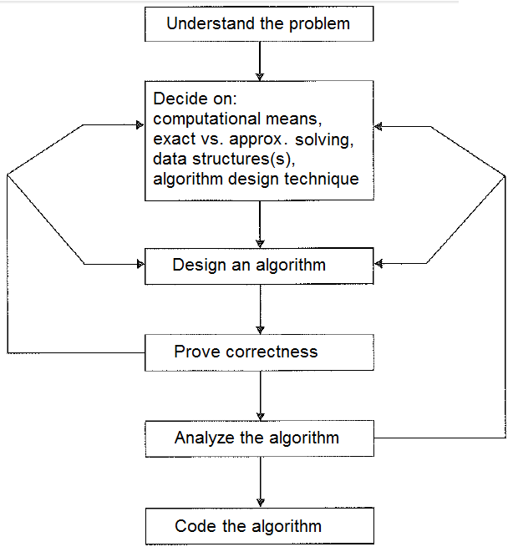

Slide 28
Algorithms are procedural solutions to problems.
An input to an algorithm specifies an instance of the problem the algorithm solves.
Boundary conditions
Sequential vs Parallel algos.
Exact vs Approximation algos.
Data Structures + Algorithms = Programs
Correctness: Not just for most the time, a correct algorithm is the one that works for all legitimate inputs.
Time vs Space efficiency. Simplicity vs Generality.
Coding the algorithm and tuning for the target platform.

Slide 29
The Course could be organized by:
Design Techniques (Brute-Force, Dynamic Programming, Divide-and-Conquer, Greedy, etc.)
Problem Types (Searching, Sorting, Graphs, etc.)
Important Problem Types:
Searching
String processing
Sorting
Graph problems
Counting problems
Geometric problems
Numerical problems

Slide 30
Searching:
Finding a search key in a given set.
There’s a lot in between Sequential/Linear Search and Binary Search.
And, with some kind of preprocessing, we can search faster than the binary search.
Searching vs Insertion/Deletion of items.

Slide 31
Algorithm SequentialSearch(A[0..n-1], K)
//Searches for a key in an array using sequential search.
//Input: An array A[0..n-1] and a search key K.
//Output: The index of the first element of A that matches K
// or -1 if there are no matching elements.
i ← 0
while (i < n) do
if (A[i] = K)
return i
i ← i + 1
endwhile
return -1
i ← 0
while (i < n) and (A[i] ≠ K) do
i ← i + 1
endwhile
if (i < n) return i
return -1

Slide 32
Algorithm SequentialSearch2(A[0..n-1], K)
//Searches for a key in an array using sequential search.
//Input: An array A[0..n-1] and a search key K.
//Output: The index of the first element of A that matches K
// or -1 if there are no matching elements.
i ← 0
A[n] ← K
while (A[i] ≠ K) do
i ← i + 1
endwhile
if (i < n) return i
return -1
t ← A[n-1]
A[n-1] ← K
i ← 0
while (A[i] ≠ K) do
i ← i + 1
endwhile
A[n-1] ← t
if (i < n-1) return i
if(t = K) return n-1
return -1

Slide 33
String Processing:
Handling non-numerical data.
A string is a sequence of characters from an alphabet. Text strings are a kind of strings.
String matching is a search problem.

Slide 34
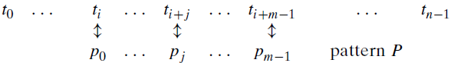
String Matching:
In an n-character text, search for the first occurrence of an m-character pattern. That is, in a text of length n, find the first substring that matches with the pattern of length m.
Find i, the index of the leftmost character of the first matching substring in the text such that

Slide 35
Naïve String Matching:
There are n-m+1 substrings of length m in a text of length n. Search for the first one that matches the pattern.
Algorithm NaiveStringMatch(T[0..n-1],P[0..m-1])
//Implements a naive string matching.
//Input: An array T[0..n-1] of n chars representing a text
// and an array P[0..m-1] of m chars representing a pattern.
//Output: The index of the first character in the text
// that starts a matching substring
// or -1 if the search is unsuccessful.
for i ← 0 to n-m
j ← 0
while (j < m) and (P[j] = T[i+j]) do
j ← j + 1
endwhile
if (j = m) return i
return -1

Slide 36
Sorting:
Rearrange the list of items in some order.
There must be a total order on the set of items.
Total order is a special case of partial order when each pair of items of the set are comparable.
Compare on “key” if the item has multiple fields.
Stable sorting algorithm preserves the relative order of any two equal elements in its input.
In-place requires no more than constant amount of extra space.

Slide 37
Write an algorithm to check if the array is sorted.
boolean isSorted( A[0..n-1] )
//Checks if the array A is sorted.
//Input: An array A of orderable elements by ≤.
//Output: Return TRUE if array is sorted.
// FALSE otherwise.
...

Slide 38
Write an algorithm to check if the array is sorted.
boolean isSorted( A[0..n-1] )
//Checks if the array A is sorted.
//Input: An array A of orderable elements by ≤.
//Output: Return TRUE if array is sorted.
// FALSE otherwise.
for i ← 0 to n-2
if(A[i] > A[i+1]) //not in order
return FALSE
return TRUE

Slide 39
Sort by fixing the problems while checking for sortedness.
SortByCheckingSortedness( A[0..n-1] )
//Sorts by Checking sortedness.
//Input: An array A of orderable elements by ≤.
//Output: Sorted array A.
for i ← 0 to n-2
if(A[i] > A[i+1])
Swap A[i] with A[i+1]
Does it sort?

Slide 40
Sort by fixing the problems while checking for sortedness.
SortByCheckingSortedness2( A[0..n-1] )
//Sorts by Checking sortedness.
//Input: An array A of orderable elements by ≤.
//Output: Sorted array A.
while (TRUE)
for i ← 0 to n-2
if(A[i] > A[i+1])
Swap A[i] with A[i+1]
if(isSorted( A[0..n-1] ))
return
Does it sort and that too in a finite amount of time?

Slide 41
Sort by fixing the problems while checking for sortedness.
SortByCheckingSortedness3( A[0..n-1] )
//Sorts by Checking sortedness.
//Input: An array A of orderable elements by ≤.
//Output: Sorted array A.
for i ← 0 to n-2 //n-1 consecutive pairs
if(A[i] > A[i+1])
Swap A[i] with A[i+1]
if(isSorted( A[0..n-1] ))
return
else SortByCheckingSortedness3(A[0..n-2])
It should sort. Can we convert recursive to iterative?

Slide 42
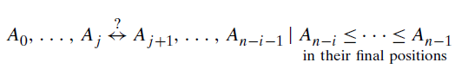
Algorithm BubbleSort( A[0..n-1] )
//Sorts by Bubble Sort algorithm.
//Input: An array A of orderable elements by ≤.
//Output: Sorted array A.
for i ← 0 to n-2 //n-1 passes
for j ← 0 to n-2-i //last i elements are sorted
if(A[j] > A[j+1])
Swap A[j] with A[j+1]
return
Where did isSorted() function go?

Slide 43
Algorithm BubbleSort2( A[0..n-1] )
//Sorts by an improved Bubble Sort algorithm.
//Input: An array A of orderable elements by ≤.
//Output: Sorted array A.
for i ← 0 to n-2 //n-1 passes
anySwaps ← FALSE
for j ← 0 to n-2-i //last i elements are sorted
if(A[j] > A[j+1])
Swap A[j] with A[j+1]
anySwaps ← TRUE
if(anySwaps = FALSE)
Break out of loop

Slide 44
Algorithm BubbleSort_Recursive(A[0..n-1])
//Sorts by an improved Bubble Sort algorithm.
//Input: An array A of orderable elements by ≤.
//Output: Sorted array A.
noSwaps ← TRUE
for i ← 0 to n-2
if(A[i] > A[i+1])
Swap A[i] with A[i+1]
noSwaps ← FALSE
if(noSwaps = TRUE)
return
else BubbleSort_Recursive(A[0..n-2])

Slide 45
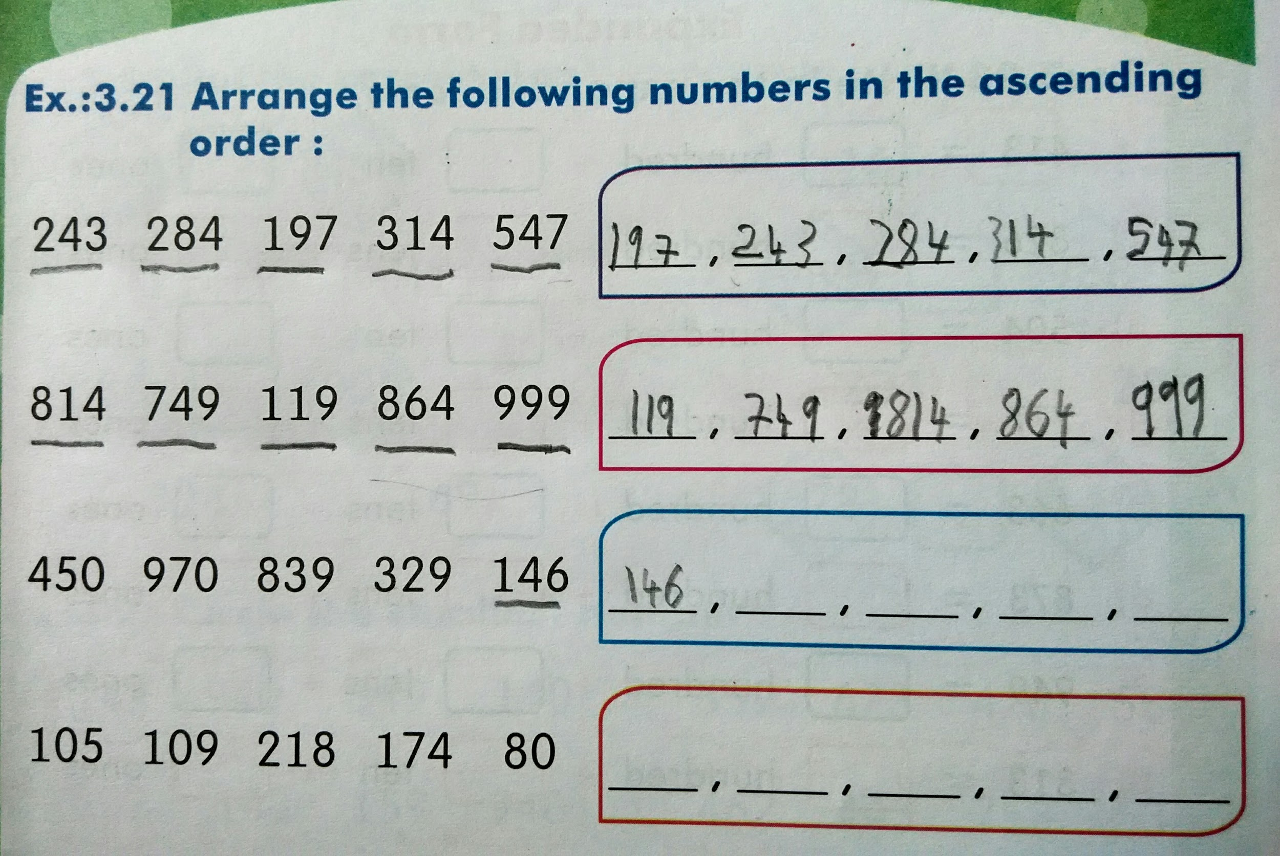
How does a kindergarten kid sort ?

Slide 46
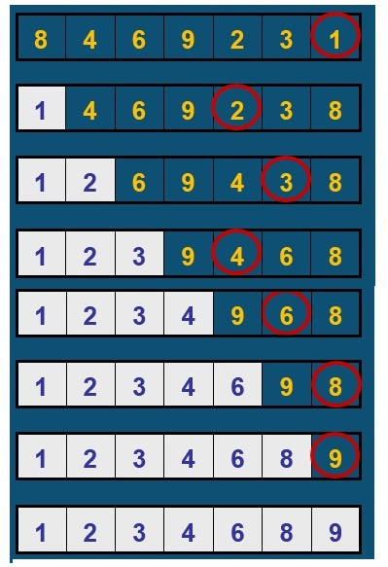
Selection Sort:
Example: 8 4 6 9 2 3 1

Slide 47
Selection Sort:
Find the smallest of the unsorted array and place it at the beginning of the unsorted array. Reduce the unsorted array by excluding the first one, which is already in its final position. Repeat sorting the unsorted array as long as there is only one element left in the unsorted array.
Algorithm SelectionSort_Recursive(A[0..n-1])
//Sorts a given array by Selection Sort.
//Input: An array A[0..n-1] of orderable elements.
//Output: Array A[0..n-1] sorted in ascending order.
if(n ≤ 1) return
min ← index of the smallest among A[0..n-1]
Swap A[0] with A[min]
SelectionSort_Recursive(A[1..n-1])

Slide 48
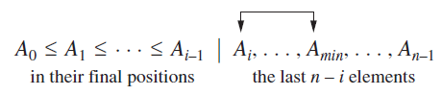
Selection Sort:
Find the smallest of the unsorted array and place it at the beginning of the unsorted array. Reduce the unsorted array by excluding the first one, which is already in its final position.
Algorithm SelectionSort(A[0..n-1])
//Sorts a given array by Selection Sort.
//Input: An array A[0..n-1] of orderable elements.
//Output: Array A[0..n-1] sorted in ascending order.
for i ← 0 to n-2
min ← index of the smallest among A[i..n-1]
Swap A[i] with A[min]

Slide 49
Algorithm SelectionSort(A[0..n-1])
//Sorts a given array by Selection Sort.
//Input: An array A[0..n-1] of orderable elements.
//Output: Array A[0..n-1] sorted in ascending order.
for i ← 0 to n-2
min ← i
for j ← i+1 to n-1
if(A[j] < A[min]) min ← j
Swap A[i] with A[min]
return A

Slide 50
Graph Problems:
Many problems in computer science can be modelled as a graph and solved using well-known graph processing algorithms.
Graph traversal
Shortest path
Topological sorting
Spanning trees
Travelling salesperson problem (TSP)
Graph-coloring
Web graph

Slide 51
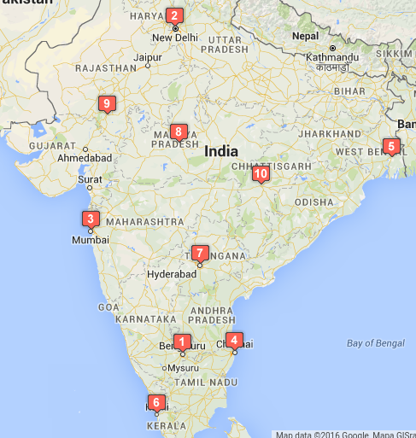
Travelling Salesman Problem:
Bengaluru
New Delhi
Mumbai
Chennai
Kolkata
Kochi
Hyderabad
Bhopal
Udaipur
Raipur

Slide 52
Travelling Salesman Problem:
Given n cities and distances between each pair of cities, find the shortest round trip that visits all other cities (and returns to the origin city).
It’s essentially finding the shortest Hamiltonian circuit.
Eg: Driving time between some 10 cities of India (Cost Matrix).
000000 110189 050573 020948 109480 034435 028433 074836 091767 068406
109006 000000 079663 118195 079397 143304 083593 045792 037923 068146
051516 080265 000000 070149 121881 083636 044745 043763 042416 067450
021557 119539 069838 000000 095820 042397 037471 084186 111032 077756
110053 081231 121373 095977 000000 134475 085826 087690 100264 054016
034488 144238 082769 041728 134042 000000 062482 108885 123963 102455
028473 084770 045153 037117 085732 062772 000000 049417 078006 042987
075056 046162 044536 084245 086579 109354 049641 000000 031151 038399
092933 037994 042414 111566 099497 125053 078960 031010 000000 068113
068718 068844 068336 077907 055357 103016 043305 038648 068634 000000

Slide 53
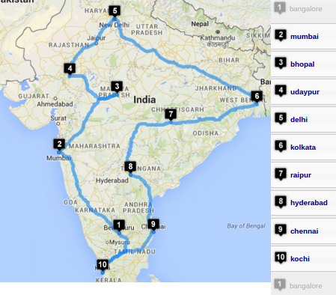
Travelling Salesman Problem:
Bengaluru
New Delhi
Mumbai
Chennai
Kolkata
Kochi
Hyderabad
Bhopal
Udaipur
Raipur
Shortest round
trip takes
454201 sec.

Slide 54
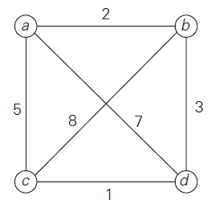
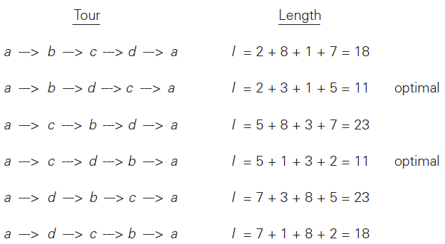
Travelling Salesman Problem:

Slide 55
ALGORITHM Travelling Salesman Problem
//Input: nxn adjacency matrix A.
//Output: Cost of min-cost Hamiltonian circuit.
mincost ← INFINITY
for each permutation of n cities
cost ← 0
for each edge in the Hamiltonian circuit
//formed by the permutation
cost ← cost + (cost of the edge)
endfor
if (cost < mincost) mincost ← cost
endfor
return mincost

Slide 56
ALGORITHM Travelling Salesman Problem
//Input: n x n adjacency matrix A. Assumed n > 1.
//Output: Cost of min-cost Hamiltonian circuit.
//getNextPermutation(P[]) returns true with next permn
//in lexicographic order if it exists, false otherwise.
mincost ← INFINITY
Perm[0..n-2] ← [1, 2, 3, …, n-1] //1st permn.
do
cost ← A[0, Perm[0]] //1st edge of the ckt
cost ← cost + A[Perm[n-2], 0] //last edge
for i ← 0 to n-3
cost ← cost + A[Perm[i], Perm[i+1]]
if (cost < mincost) mincost ← cost
while(getNextPermutation(Perm[0..n-2]))
return mincost

Slide 57
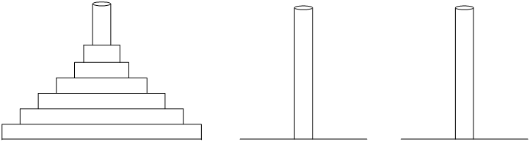
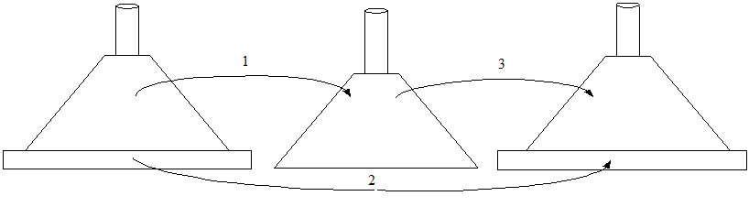
Tower of Hanoi puzzle:

Slide 58
Algorithm Hanoi(n, Src, Dest, Int)
//Move n disks from Src peg to Dst peg as per the Tower of Hanoi puzzle.
//Input: n (nonnegative int) disks and three pegs.
//Output: Movement of disks between pegs in the order
// of solving the puzzle.
if (n = 0) Return
Hanoi(n-1, Src, Int, Dst)
Move disk n from Src to Dst
Hanoi(n-1, Int, Dst, Src)
Return
On a lighter note:
To move n disks (where n > 1) from the source peg to the destination peg, at least one extra peg is essential, and it takes 2^{n}-1 moves.
Adding more extra pegs will make things interesting! Doesn’t it?
How many steps does it take when there are two extra pegs instead of just one? When there are n-1 extra pegs, we need just (n-1)+1+(n-1) = 2n-1 steps. Even though adding more extra pegs makes things interesting, adding more than n-1 extra pegs is useless!

Slide 59
</ Introduction to Algorithms >

